Slide 1
Why should researchers care about data curation?
Varsha Khodiyar

Slide 2
Why share data

Slide 3
Expenditure on data generation
16.8% NIH grant applications funded*
Hours spent writing grants?
Hours spent reviewing grants?
Resources are finite/expensive
Modified animals
Specialized reagents
Time and effort to generate good, valid data
* For fiscal year 2013 (http://report.nih.gov/success_rates/Success_ByIC.cfm)

Slide 4
Reproducibility is a cornerstone of science
“[W]e evaluated the replication of data analyses in 18 articles on microarray-based gene expression profiling published in Nature Genetics in 2005–2006...We reproduced two analyses in principle and six partially or with some discrepancies; ten could not be reproduced. The main reason for failure to reproduce was data unavailability.”
Ioannidis JPA. et al. Repeatability of published microarray gene expression analyses. Nature Genetics 41, 149–55 (2009)

Slide 5
How to share data

Slide 6
Data needs to be…
Discoverable
Need to know it’s there
Accessible
Must be able to get to the data
Usable
Require sufficient information about how the data was generated
Persistent
Historical data access as part of the scientific record, as well as for new research
Reliable
Data provenance informs data reuse decisions

Slide 7
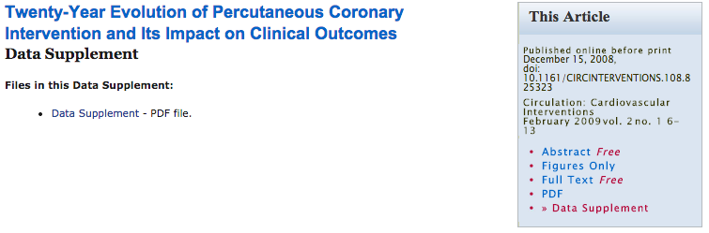
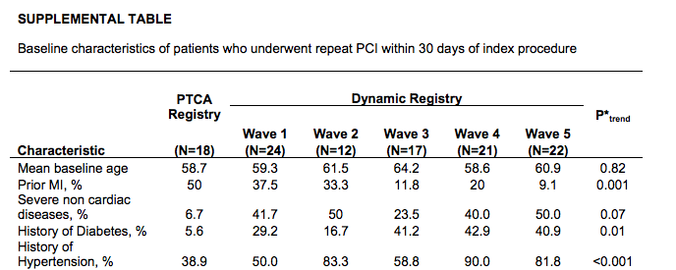
Traditional publishing
Data in a PDF is discoverable and accessible, by readers of the paper
But is not usable - can't manipulate data in a PDF table

Slide 8
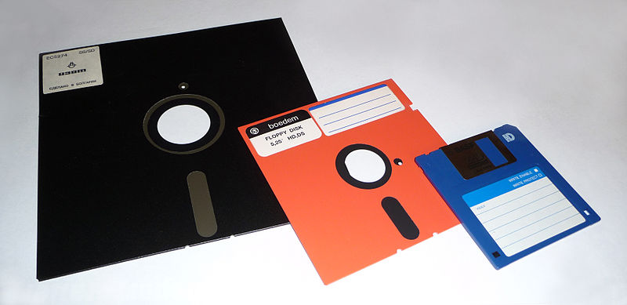
I’ll send my data when someone asks for it
“We examined the availability of data from 516 studies between 2 and 22 years old
The odds of a data set being reported as extant fell by 17% per year
Broken e-mails and obsolete storage devices were the main obstacles to data sharing”
Vines TH. et al. The availability of research data declines rapidly with article age. Curr Biol 24, 94–7 (2014)

Slide 9
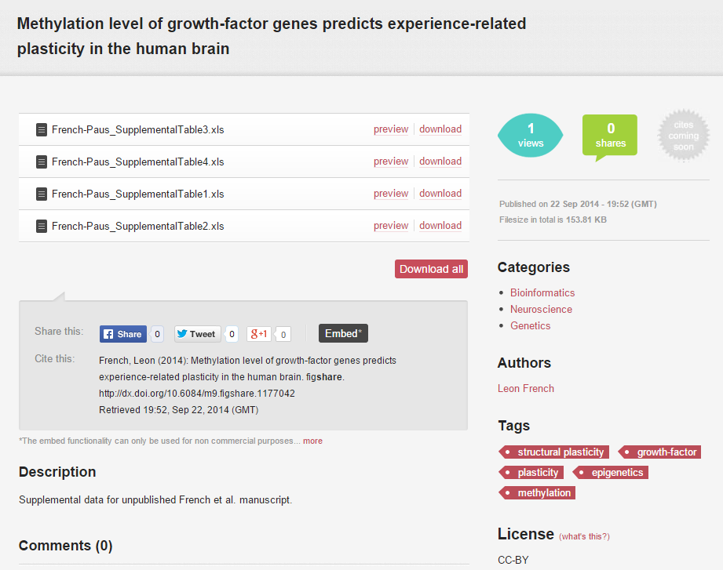
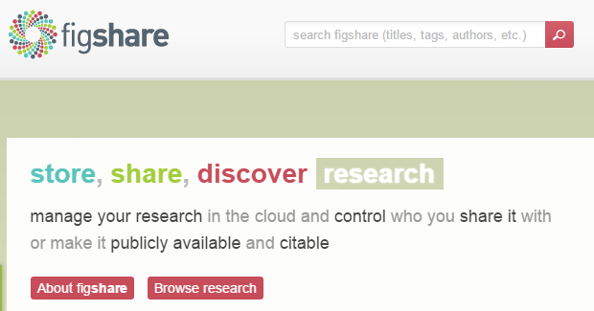
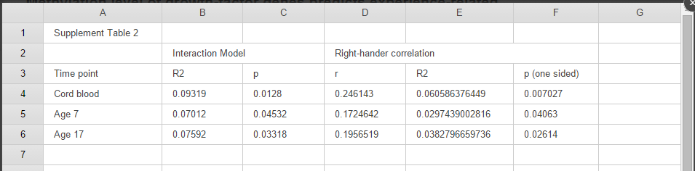
I’ll make my data available in a repository
Data is discoverable, accessible and persistent
But data may not be usable, as limited space for data-specific description in an unstructured repository

Slide 10
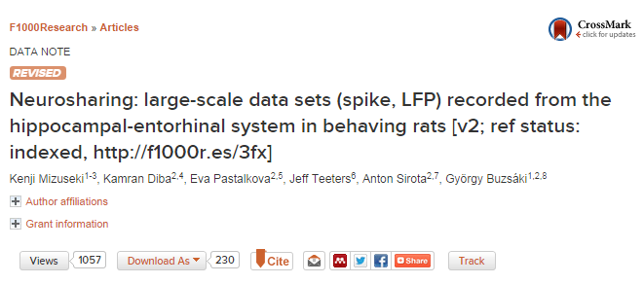
I’ll write a data paper
Materials and Methods
Animal surgery
Behavioural testing
Data collection and cell-type classification
Data description
Data file organization
Metadata organization
Data is discoverable, accessible and persistent
Sufficient space for methodological detail

Slide 11
But are we missing something?

Slide 12
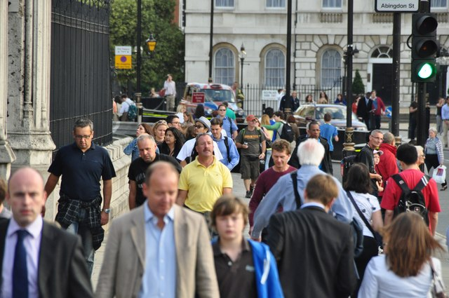

Human vs. machine
Is your data truly discoverable by researchers outside your own domain?
Too many papers to read in each person’s own field.
Could increasing the machine readability of your data result in increased use of your data?
Is making an entire dataset machine readable, feasible?

Slide 13
Metadata
Fully describe the experiments that generated the data
Takes time to ensure full metadata capture
Structure the metadata to ensure machine readability
Structure needs to be decided prospectively
Metadata can be discovered in automated way
Requires relevant infrastructure

Slide 14
Curation is a specialised task
Researchers are not data management professionals
Learning how to curate data, takes time
Article publication is carried out by specialists (journals).
Follows that data publication should also be carried out by specialists.

Slide 15
Benefits of curated metadata
Users of data
Data is findable
Data provenance is clear
Increased data usability
Reduce unnecessary duplication of data
Data generators
Data more likely to be used, so data citation rates will increase
Contribute to novel research that data generators would not have carried out

Slide 16
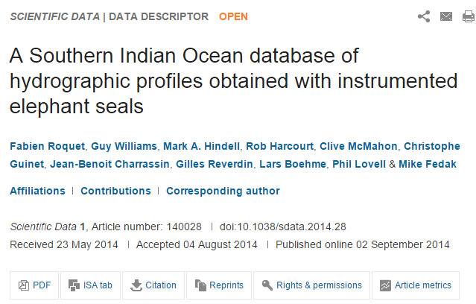
Metadata as an integral part of a data paper

Slide 17
Future possibilities

Slide 18
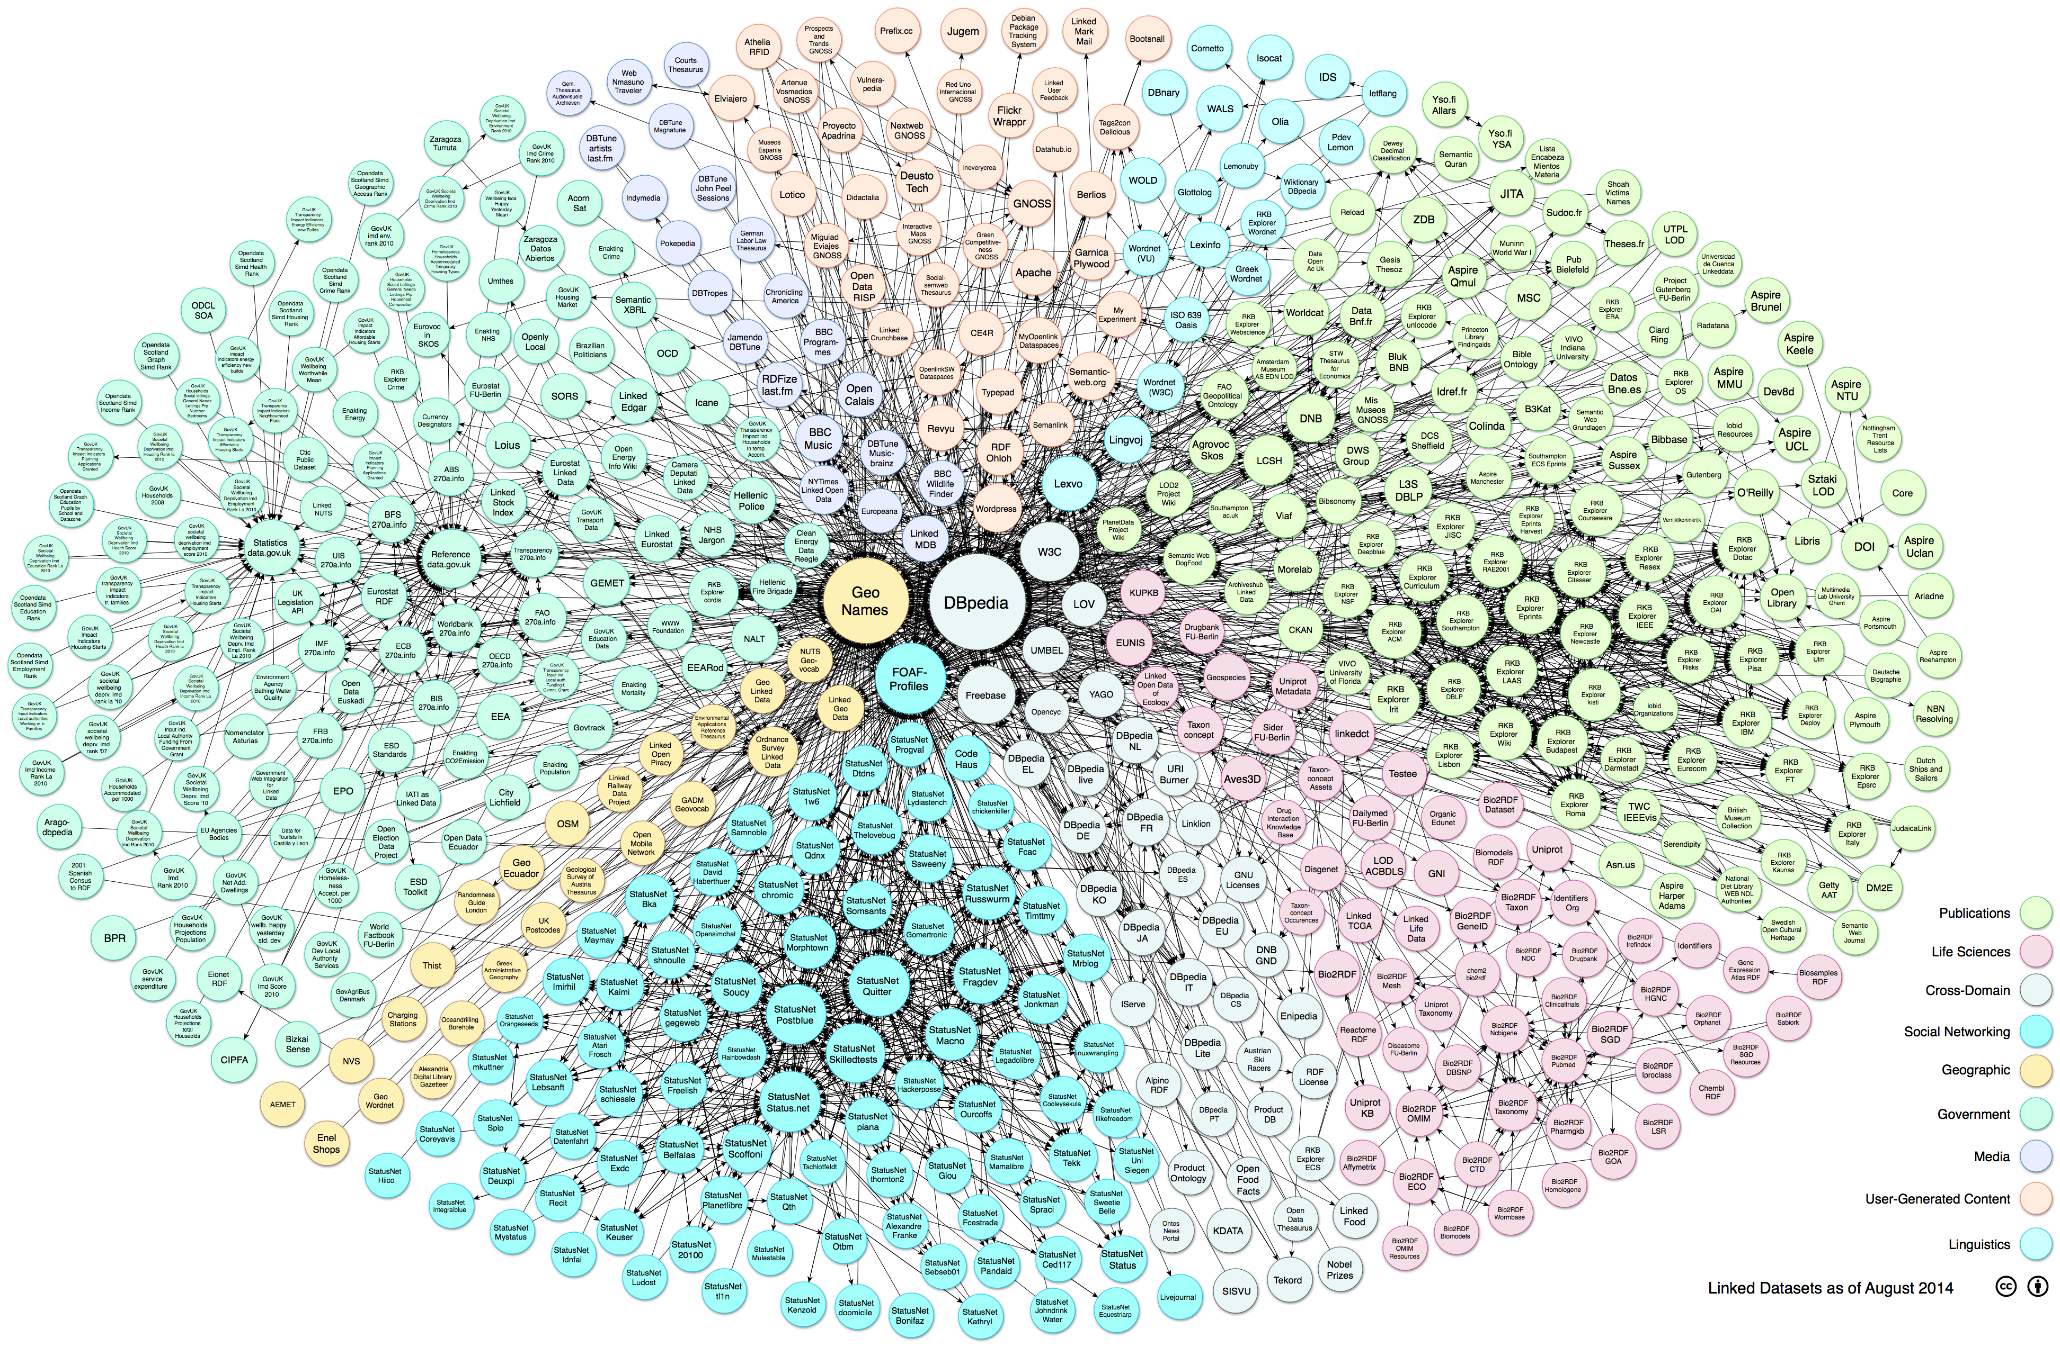
Machine readable research metadata could lead to...
Infrastructure for linked research data is being developed
Linked Data
a way to publish data so that data from different sources can be connected and queried
"Linking Open Data cloud diagram 2014, by Max Schmachtenberg, Christian Bizer, Anja Jentzsch and Richard Cyganiak. http://lod-cloud.net/"

Slide 19
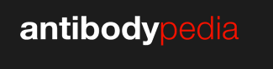
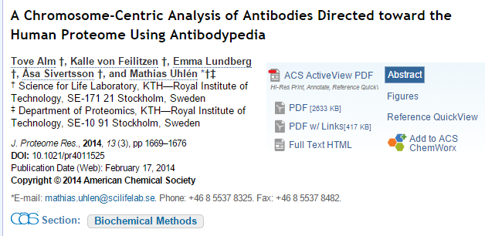
The beginnings of linked research data
An open-access database of publicly available antibodies against human protein targets, with user and provider data on antibody efficacy in a range of assays.
“We show that Antibodypedia may be used to track the development of available and validated antibodies to the individual chromosomes, and thus the database is an attractive tool to identify proteins with no or few antibodies yet generated.”

Slide 20
Summary
Reusing previously generated data is economical
Data reuse dependant on discoverable, accessible and usable shared datasets
Descriptive metadata enhances (re)usability of data
Capture of structured metadata is a specialist skill
The future: machine readable metadata will be important

Slide 21

Thanks for listening...

